Slide 1
Loss Of Nitrogen From Soil In Farms And The Solutions To This
By Alex Priest

Slide 2
The Problem
Nitrogen is used in plants.
However, nitrogen in the atmosphere is not useful to plants.
Plants therefore need other, more reactive chemicals.
For these chemicals to form, nitrogen from the atmosphere needs to be ‘fixed’. There are a number of ways this can occur:
Lightning in the atmosphere.
Industrial processes.
Bacteria.
Legumes, which include beans, peas, peanuts, lentils, and more, can fix their own nitrogen.

Slide 3
The Solutions
Nitrogen Fertilisers In Pesticides
Pesticides can be applied to crops.
Fertilisers, often containing nitrogen, can be added to these.
Organic Farming
Synthetic, nitrogen containing pesticides, cannot be used by organic farmers. To replenish nitrogen, farmers therefore use other, more natural methods:
Manure produced by animals is spread around the base of crops.
Other techniques, including crop rotation, are also used by organic and conventional farmers alike.

Slide 4
The Solutions
Genetic Modification (GM)
Crops can be modified to reduce the need for adding extra nitrogen in multiple ways:
Modified to absorb nitrogen more efficiently.
Modified to fix their own nitrogen.
Crop Rotation
Different crops, including legumes, can be planted at different times of year.
This allows each type of crop to produce its own unique nutrients, some of which is then left behind for the following crops.

Slide 5
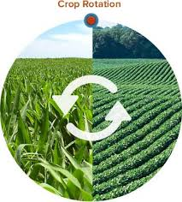
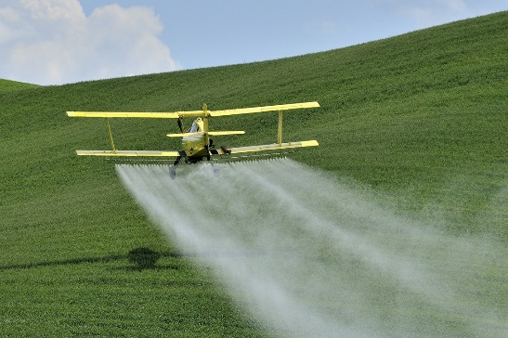

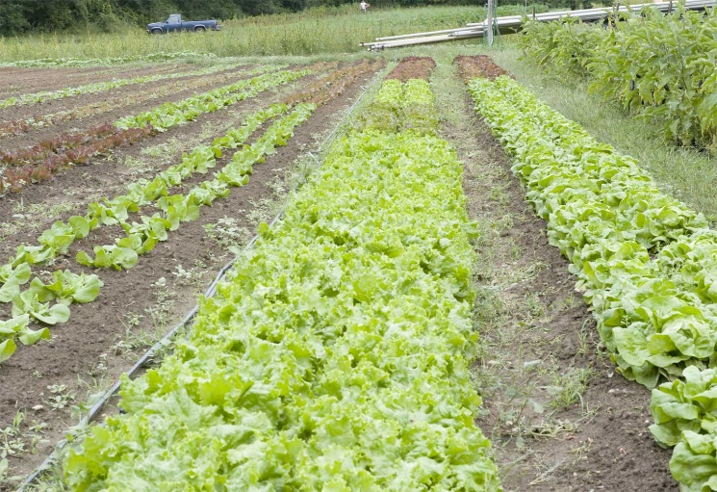
The Advantages And Disadvantages of Each Solution

Slide 6
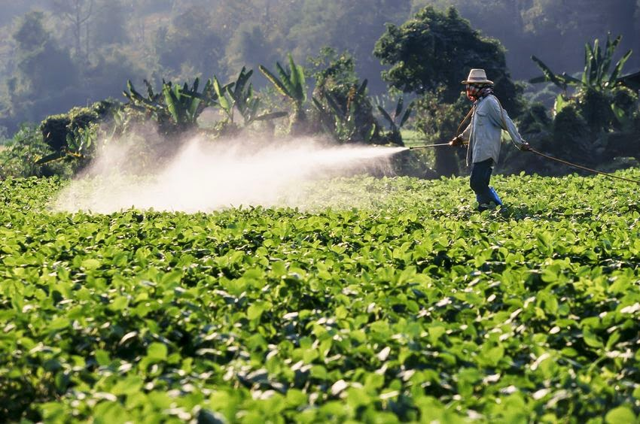
Solution 1: Nitrogen Fertilizer In Pesticides

Slide 7

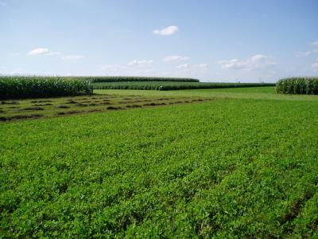
The Advantages
Creates
Not Much Money
A Large Amount Of Crops

Slide 8
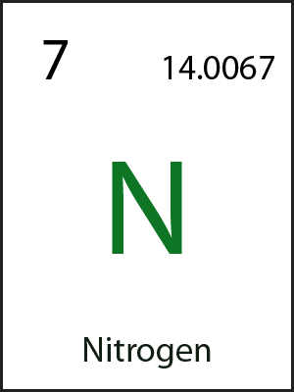
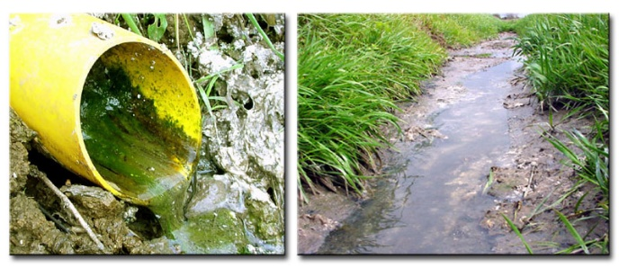
SO
Pesticides Are Often Used Anyway
Will Cause
Adding Nitrogen To Pesticides
No Extra Environmental Damage

Slide 9
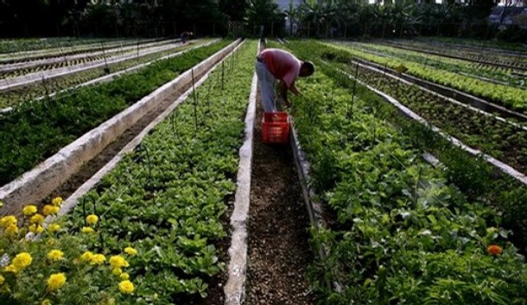
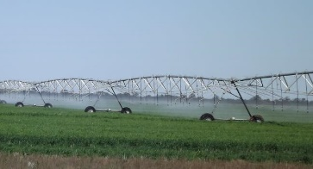



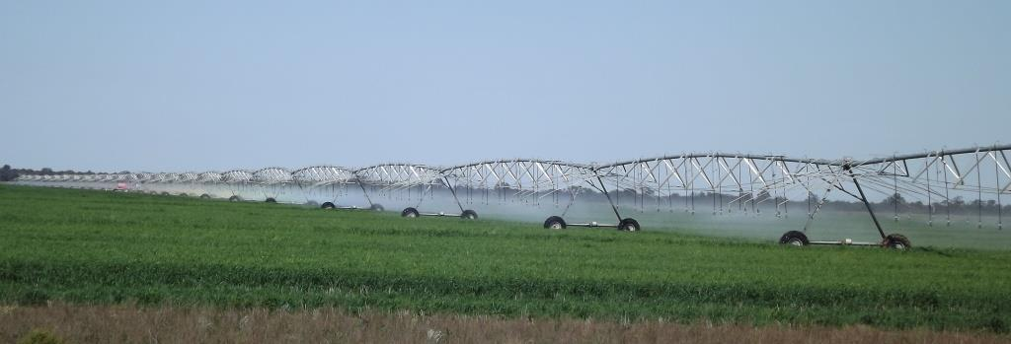
The Disadvantages
THEREFORE
Using Pesticides On
Doesn’t Work That Well
Using Pesticides On
Small Scale Farms
Works Well
Small Scale Farming Is Disadvantaged
Large Scale Farms

Slide 10
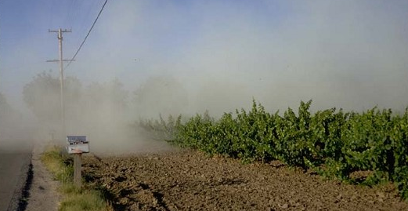
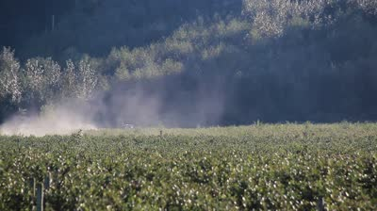
Pesticides Spread Through The Air Onto Other Farms.
Excess Pesticides Pollute The Environment

Slide 11
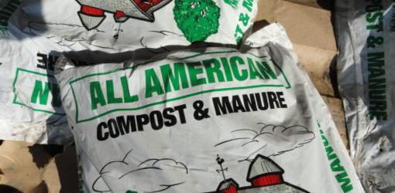
Solution 2: Organics – Using Manure As A Fertilizer

Slide 12

The Advantages
Using Manure As Fertilizer Is A Good Use Of Manure
Synthetic Pesticides, Which Are Bad For The Environment, Are Not Used
Also
Manure Fertiliser Is More Natural Than Other Methods, Making It Seem More Healthy

Slide 13
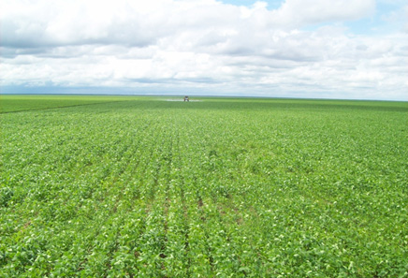
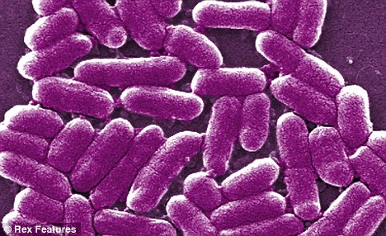
The Disadvantages
Organic Farming
Conventional Farming
The World Only Has The Resources For Organics To Feed 4 Out Of 8 Billion People
Takes Up More Land Per Output Than
Organic Foods Are More Likely To Cause Food Poisoning

Slide 14
Using Manure (+more) On
THEREFORE
Using Manure (+more) On
Works Well
Small Scale Farms
Doesn’t Work That Well
Large Scale Farming Is Disadvantaged
Large Scale Farms

Slide 15
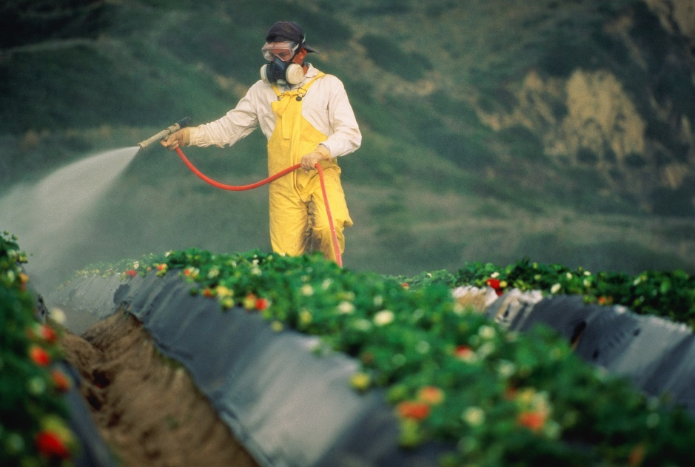
The Disadvantages – Organic Pesticides
Most Certified Organic Farms Use Organic Pesticides
Organic Pesticides are raw, natural chemicals, from plants and animals or other, non-living sources.
The use of organic pesticides in America is not monitored.
The use of synthetic pesticides is monitored.
Organic pesticides’ safety is tested far less than that of synthetic pesticides.
Most organic pesticides are less effective.
People buy organic products thinking they contain no pesticides.

Slide 16
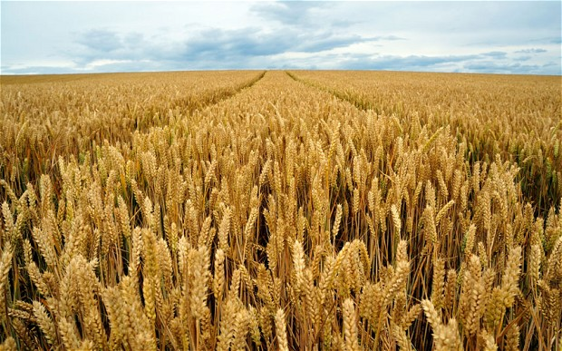
Solution 3: Genetic Modification To Reduce The Need For Extra Nitrogen

Slide 17


The Advantages
Then
Creates
The Genetically Modified Crop
A Large Amount Of Researcher’s Money
Creates
A Small Amount Of Farmer’s Money
A Large Amount Of Crop

Slide 18

Nitrogen Efficient Or Pest Resistant Crops
Reduced Or No Pesticide Use
GM crops are tested for about 10 years, whereas other crops are not.

Slide 19
Genetic Modification by Not-For-Profit Organisations
THEREFORE
Planting GM Crops On
Planting GM Crops On
Is Affordable
Neither Kind Of Farming Is Disadvantaged
Small Scale Farms
Is Affordable
Large Scale Farms

Slide 20
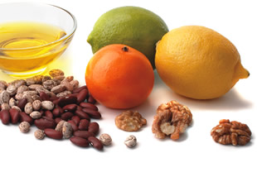
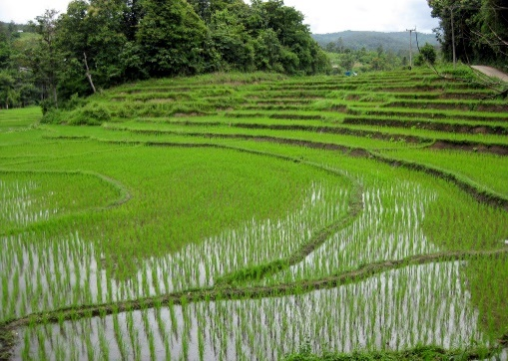
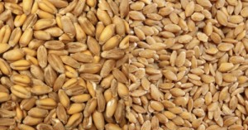
Other Benefits Of Genetic Modification
GM Wheat
Non-GM Wheat
Individual Nutrients Can Be Added To Foods
Food Production Can Be Increased

Slide 21
The Disadvantages
Genetic Modification by For-Profit Companies
THEREFORE
Planting GM Crops On
Planting GM Crops On
Is Often Affordable
Small Scale Farms
Is Affordable
Small Scale Farming Is Partially Disadvantaged
Large Scale Farms

Slide 22

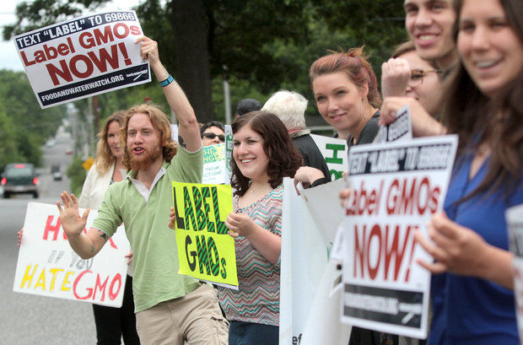
GM
Natural
SO
GM foods are often considered unhealthy and damaging to the environment

Slide 23
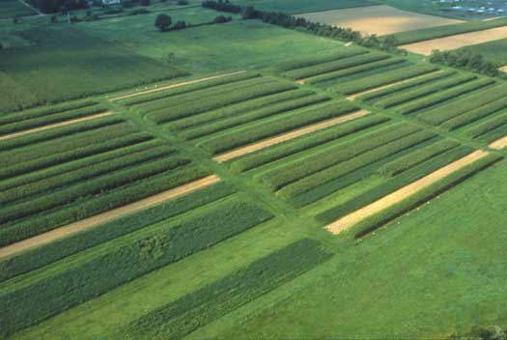
Solution 4: Crop Rotation

Slide 24


The Advantages
Using Crop Rotation Combined With
Works Well
Any Other Method

Slide 25
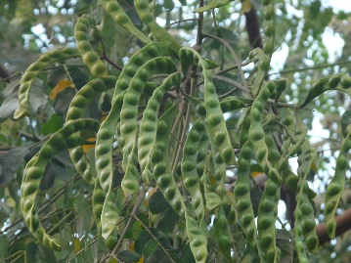
Purely legume farms can have too much nitrogen, damaging the environment
So
It can be used with or without pesticides
Rotating Legumes With Other Crops Is The Best Way To Farm Legumes

Slide 26
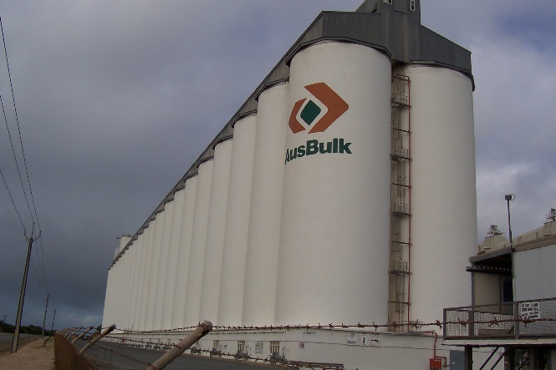


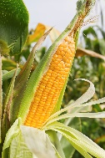
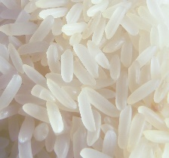
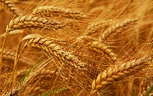
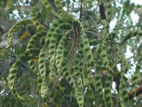



The Disadvantages
THEREFORE
Is
Buying Large Quantities Of Seeds
Cheap Per Amount Of Seed
Buying Multiple Crops Is Not Always As Cheap As Buying One Crop
Buying Large Quantities Of Seeds
Buying Multiple Crops

Slide 27
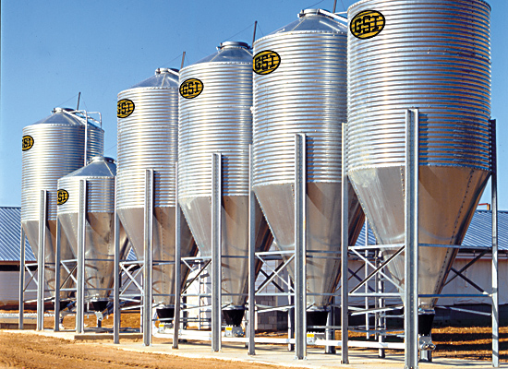
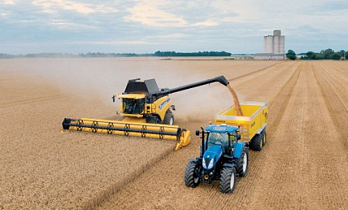
Systems Need To Be Modified To Support Multiple Or Different Crops
New Machinery May Need To Be Purchased For New Crops

Slide 28
Summary & my View
Overall, crop rotation appears to be the option with the most benefits and least disadvantages.
However, crop rotation is considered an organic method, meaning it is already included in the ‘Organics can only feed 4 billion people’ fact.
This means it cannot be used solely by itself.
Pesticides are probably the most damaging solution, and only have the advantage of being cheap on large scale and some small scale farms.

Slide 29
Summary & My View
Organics, though a very good idea, have the disadvantages of not allowing the use of pesticides and genetic modification, taking up far more land, and simply being unable to feed all 8 billion people.
Genetic Modification is usually quite affordable to farmers, and is not in itself environmentally damaging or unhealthy.
It has, however, been used to create pesticide resistant crops, encouraging pesticide use and therefore damaging the environment.
The most effective and sustainable solution would, in my opinion, be combining the best aspects of Genetic Modification, Crop Rotation, and the use of manure, even though each is supported by groups with opposing views, and having no or very little use of pesticides.

Slide 30
Bibliography - Websites
http://www.offthegridnews.com/survival-gardening-2/6-effective-methods-to-replenish-nutrients-in-your-soil/
http://www.tutorvista.com/content/biology/biology-i/natural-resources/soil-conservation.php
http://www.perennia.ca/Fact%20Sheets/Other/Soils/Soil_conservation.pdf
http://www.biofortified.org/2014/02/conservation-tillage/
http://grist.org/food/soil-proprietor-do-gmos-promote-dirt-conservation/
http://bioscience.oxfordjournals.org/content/55/7/573.full.pdf
http://blogs.scientificamerican.com/science-sushi/2011/07/18/mythbusting-101-organic-farming-conventional-agriculture/
http://www.scientificamerican.com/article/organic-farming-yields-and-feeding-the-world-under-climate-change/
http://en.wikipedia.org/wiki/Legume
http://en.wikipedia.org/wiki/Ammonia
http://archive.bio.ed.ac.uk/jdeacon/microbes/nitrogen.htm
http://www.nature.com/scitable/knowledge/library/biological-nitrogen-fixation-23570419
http://www.omafra.gov.on.ca/english/engineer/facts/05-073.htm
http://www.extension.umn.edu/agriculture/nutrient-management/nitrogen/understanding-nitrogen-in-soils/
http://www.grammarly.com/handbook/punctuation/other-punctuation-marks/4/slash/
https://cosmosmagazine.com/life-sciences/there-room-organics
https://cosmosmagazine.com/life-sciences/speak-devil
https://cosmosmagazine.com/society/senseless-fight
https://cosmosmagazine.com/society/father-green-revolution
https://cosmosmagazine.com/life-sciences/citrus-fightback
http://www.gmo-safety.eu/focus/1413.nitrogen-efficiency-genetic-engineering.html
https://www.ipni.net/ppiweb/bcrops.nsf/$webindex/90DDC9214EC7DB0A8525750600529B78/$file/BC08-4p16.pdf
http://hsc.csu.edu.au/agriculture/production/3363/nitrogen.htm
https://www.proposalkit.com/htm/how-to-write-a-green-environmental-proposal.htm
http://www.wikihow.com/Make-Organic-Pesticide
http://blogs.scientificamerican.com/science-sushi/2011/07/18/mythbusting-101-organic-farming-conventional-agriculture/

Slide 31
Bibliography - Images
http://msucares.com/crops/soils/images/nitrogen.gif
http://www.omafra.gov.on.ca/english/engineer/facts/05-073f1.gif
http://upload.wikimedia.org/wikipedia/en/f/fa/OrganicAcres.gif
http://s234.photobucket.com/user/biopact3/media/biopact_crop_rotation_legumes.gif.html
http://steadfastfinances.com/blog/wp-content/uploads/2011/03/Genetically-Modified-Foods-Which-country-leads-the-world-in-GMO-farming-and-agriculture.gif
http://fracturedparadigm.com/wp-content/uploads/2013/04/world_GM_crops.gif
http://www.ers.usda.gov/media/780133/pesticideuse_chart_3.png
http://www.farmxchange.org/wp-content/uploads/2013/05/Pesticide-use-in-US-1964-2004.png
http://scientificbeekeeping.com/scibeeimages/fig-014.png
https://www.motherjones.com/files/gmo-charts_top10.png
http://www.organic-world.net/fileadmin/images_organicworld/yearbook/2011/Folie2.PNG
http://www.itmonline.org/image/gmo2.jpg
http://cls.casa.colostate.edu/transgeniccrops/images/Globalareatranscrops.jpg
http://www.viewsoftheworld.net/wp-content/uploads/2012/12/OrganicAgricultureMap.jpg
http://newfarm.rodaleinstitute.org/depts/NFfield_trials/0903/images/FSTariel525.jpg
http://www.calacademy.org/sites/default/files/sciencetoday/wp-content/uploads/2010/05/21640_web.jpg
http://glocalkhabar.com/wp-content/uploads/2014/08/roundup_lymphoma_pesticide_exposure.jpg
http://www.cruiserlinks.com/wp-content/uploads/Nitrogen.gif
http://upload.wikimedia.org/wikipedia/commons/d/dd/Drainage_nitrates_vers_HondeghemFr_2003_04_09.jpg
http://ewealthfinance.com/ewealthfinancecom/images/australian_money.jpg
http://ucanr.edu/sites/_http___ucanrorg_sites_KREC/files/42412display.jpg
https://grist.files.wordpress.com/2013/10/crop-dusting-pesticide-roundup-field-plane-featured.jpg
http://ak5.picdn.net/shutterstock/videos/7403038/preview/stock-footage-clouds-of-pesticide-drift-through-the-air-while-farmers-spray-their-crops-agricultural-pesticide.jpg
http://www.trinigourmet.com/index.php/urban-farming-a-small-scale-solution-to-a-full-scale-problem/
http://www.king-ranch.com/wp-content/uploads/2013/09/photo_operations.jpg
http://www.utexas.edu/features/graphics/2009/cuatrocienegas/slideshows/troubled_waters/600_450/cuatro_cie_8_0030.jpg
http://www.saudi-investment-group.com/wp-content/uploads/2014/02/sustainable-agriculture.jpg
http://pftagg.com.au/images/Irrigation_Efficiency.jpg
https://www.proposalkit.com/img/green-environment.jpg
http://www.todayshomeowner.com/wp-content/uploads/2011/08/organic-nitrogen-sources-1.jpg
http://static.guim.co.uk/sys-images/Guardian/Pix/pictures/2012/1/19/1326980129227/rice-duck-pesticides-005.jpg
http://www.healingthebody.ca/wp-content/uploads/2014/08/pesticide-spraying-.jpg
http://en.mercopress.com/data/cache/noticias/18618/0x0/510edf6407a8f6cbe44096434d7ef03b.jpg
http://i.dailymail.co.uk/i/pix/2010/07/28/article-1298469-01C81E33000004B0-529_468x286.jpg
https://www.mitsui.com/jp/en/release/2013/__icsFiles/artimage/2013/09/03/cje_4_13/en_130903_03.jpg
http://vtdigger.org/vtdNewsMachine/wp-content/uploads/2011/09/20110915_lettuce.jpg
http://www.keycompounding.com/wp-content/uploads/2014/07/DNA.jpg
http://www.onefaithonechurch.com/wp-content/uploads/2014/05/wheat_2225018b.jpg
http://bed56888308e93972c04-0dfc23b7b97881dee012a129d9518bae.r34.cf1.rackcdn.com/sites/default/files/nutrient_library_intro.jpg
http://wakeup-world.com/wp-content/uploads/2014/03/GMO-Golden-Rice-Activists-Speak-Out.jpg
http://news.thaivisa.com/wp-content/uploads/2015/02/Rice_fields_Chiang_Mai.jpg
http://www.thehealthyhomeeconomist.com/wp-content/uploads/2015/03/modern-wheat-vs-einkorn.jpg
http://www.hdwallpapersinn.com/wp-content/uploads/2015/02/Natural-Hd-wallpapers-statspic.jpg
http://lgimages.s3.amazonaws.com/data/imagemanager/52738/gmo.jpg
http://upload.wikimedia.org/wikipedia/commons/b/ba/GMO_maize_test.jpg
https://greenoughgarage.files.wordpress.com/2010/07/gm-milford-proving-ground.jpg
http://upload.wikimedia.org/wikipedia/commons/b/b5/GMO_Full_Disclosure_Advocate.jpg
http://imgick.nj.com/home/njo-media/width620/img/gloucestercounty_impact/photo/15073669-mmmain.jpg
http://www.ces.ncsu.edu/wp-content/uploads/2014/12/crop-rotation.jpg
http://media.tumblr.com/4a4570a1d8e3f184754d2733b0b00eec/tumblr_inline_mm8d4yIHAe1qz4rgp.jpg
http://lh4.ggpht.com/-5MZmzreiSAo/UfFpKSJlm1I/AAAAAAAAJws/SrrB3MaJT08/crop-rotation_thumb%25255B2%25255D.jpg?imgmax=800
http://www.gardeningknowhow.com/wp-content/uploads/2012/06/legume-plant.jpg
http://www.grainsystems.com/images/storage/bft_tanks.jpg
http://upload.wikimedia.org/wikipedia/commons/1/14/Port_Giles_silos.jpg
http://doctorauer.com/wp-content/uploads/2011/04/wheatfield1.jpg
http://rampages.us/dayritcd/wp-content/uploads/sites/2775/2014/10/corn-stalk.jpg
http://www.asmatex.com/wp-content/uploads/2014/11/original1.686927.1.jpg
http://upload.wikimedia.org/wikipedia/commons/b/b7/Rice_p1160004.jpg
http://australianmercy.org/wp-content/galleries/Media/long_grain_white_rice.jpg
http://i.dailymail.co.uk/i/pix/2013/04/13/article-0-1639445D000005DC-998_634x396.jpg
http://blogs.mcall.com/.a/6a00d8341c4fe353ef0168e7e87e60970c-800wi
http://patwelsh.com/wpmu/files/crop-rotation.jpg

